Slide 1

CHAPTER 5
Activity-Based Costing
and
Activity-Based Management

Slide 2
Background
Recall that overhead is applied to production (or services) in a rational systematic manner, using some type of averaging. There are a variety of methods.
These methods often involve trade-offs between simplicity and realism.
Simple Methods Complex Methods
Unrealistic Realistic

Slide 3
Broad Averaging
Historically, firms produced a limited variety of goods while their indirect costs were relatively small.
Allocating overhead costs was simple: use broad averages to allocate costs uniformly regardless of how they are actually incurred.
  “Peanut-butter” costing
The end-result: overcosting and undercosting

Slide 4
Over and Undercosting
Overcosting—a product consumes a low level of resources but is allocated high costs per unit.
Undercosting—a product consumes a high level of resources but is allocated low costs per unit.

Slide 5
Under- and Over-costing Example
Irene, Roberta, and Nancy are three bank customers.
They require different activities from the bank:
  Irene banks exclusively at the ATM.
  Roberta visits the teller daily to make deposits, withdrawals
  Nancy deposits foreign currency as well as calling the branch frequently to ask currency rates.

Slide 6
Cross-subsidization problem
The results of overcosting one cost object (product, service, customer, etc.) and undercosting another.
The overcosted object absorbs too much cost, making it seem less profitable than it really is.
The undercosted object is left with too little cost, making it seem more profitable than it really is.

Slide 7
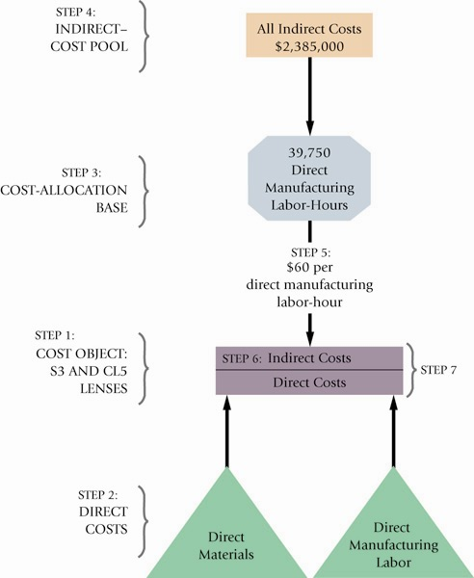
An Example:
Plastim

Slide 8
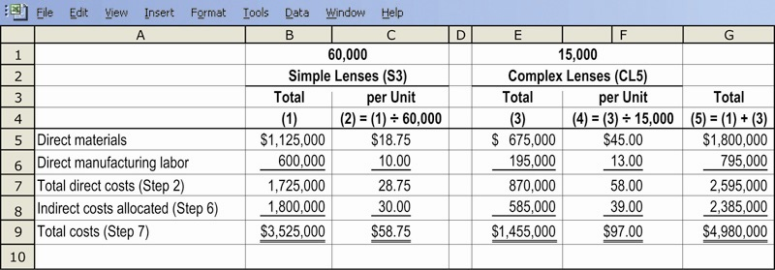
Plastim and Simple Costing

Slide 9
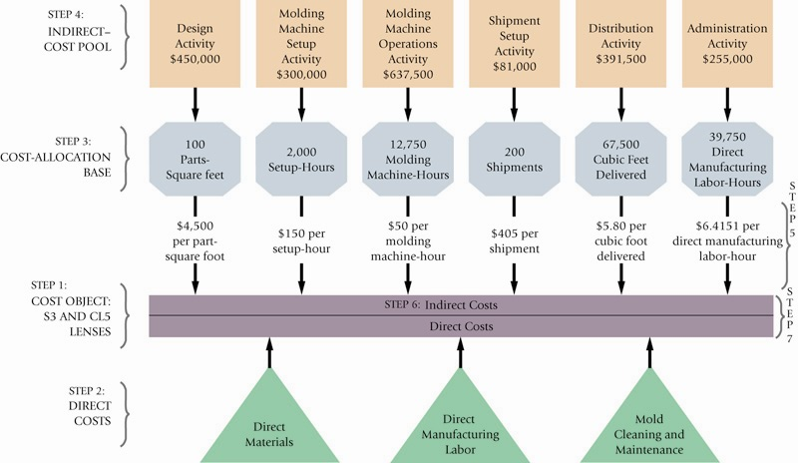
Plastim and ABC Illustrated

Slide 10
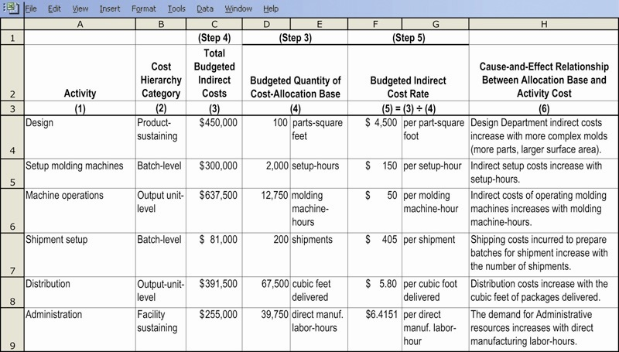
Plastim and ABC Rate Calculation

Slide 11
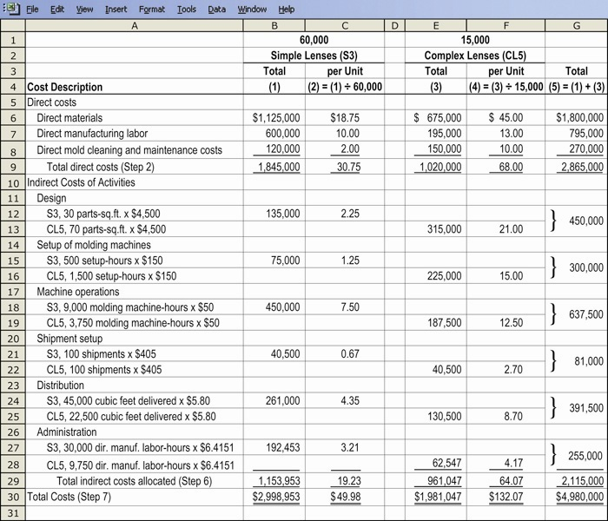
Plastim and ABC Product Costs

Slide 12
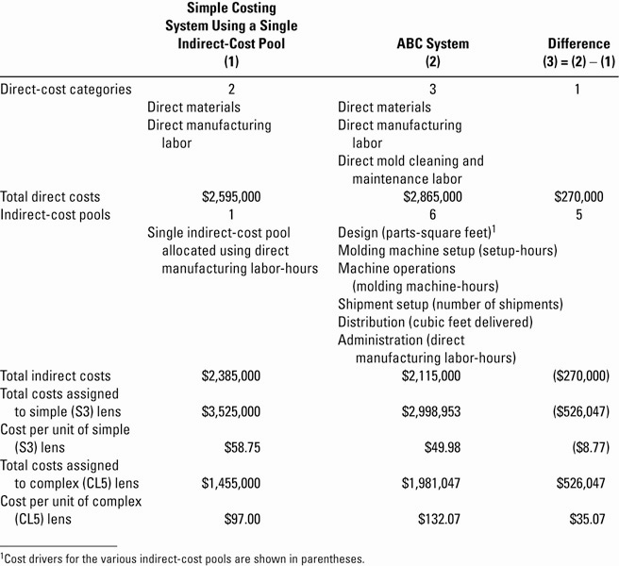
Plastim: Simple and ABC Compared

Slide 13
Conclusions
Each method is mathematically correct.
Each method is acceptable.
Each method yields a different cost figure, which will lead to different gross margin calculations.
Only overhead is involved. Total costs for the entire firm remain the same—they are just allocated to different cost objects within the firm.
Selection of the appropriate method and drivers should be based on experience, industry practices, as well as a cost-benefit analysis of each option under consideration.

Slide 14
A Cautionary Tale
A number of critical decisions can be made using this information:
  Should one product be “pushed” over another?
  Should one product be dropped?
Accounting for overhead costs is an imprecise science. Accordingly, best efforts should be put forward to arrive at a cost that is fair and reasonable.

Slide 15
Reasons for Selecting a More Refined Costing System
Increase in product diversity
Increase in indirect costs
Advances in information technology
Competition in foreign markets

Slide 16
Cost Hierarchies
ABC uses a four-level cost structure to determine how far down the production cycle costs should be pushed:
  Unit-level (output-level)
  Batch-level
  Product-sustaining-level
  Facility-sustaining-level

Slide 17
ABC vs. Simple Costing Schemes
ABC is generally perceived to produce superior costing figures due to the use of multiple drivers across multiple levels.
ABC is only as good as the drivers selected, and their actual relationship to costs. Poorly chosen drivers will produce inaccurate costs, even with ABC.

Slide 18
Activity-Based Management
A method of management that uses ABC as an integral part in critical decision-making situations, including:
  Pricing and product-mix decisions
  Cost reduction and process improvement decisions
  Design decisions
  Planning and managing activities

Slide 19
Signals (Red Flags?) that Suggest that ABC Implementation Could Help a Firm:
Significant overhead costs allocated using one or two cost pools
Most or all overhead is considered unit-level
Products that consume different amounts of resources
Products that a firm should successfully make and sell consistently show small profits
Operations staff disagreeing with accounting over manufacturing and marketing costs

Slide 20
ABC and Service/Merchandising Firms
ABC implementation is widespread in a variety of applications outside manufacturing, including:
  Health Care
  Banking
  Telecommunications
  Retailing
  Transportation

