Slide 1
CHAPTER 19
Balanced Scorecard:
Quality and Time—modified by CB

Slide 2
Quality as a Competitive Tool
Quality—the total features and characteristics of a product or a service made or performed according to specifications to satisfy customers at the time of purchase and during use.
A quality focus reduces costs and increases customer satisfaction.

Slide 3
Quality as a Competitive Tool
Focusing on the quality of a product will generally build expertise in producing it, lower the costs of making it, create customer satisfaction for customers using it, and generate higher future revenues for the company selling it.

Slide 4
Two Basic Aspects of Quality
Design quality—refers to how closely the characteristics of a product or service meet the needs and wants of customers
Conformance quality—refers to the performance of a product or service relative to its design and product specifications

Slide 5
Quality and Failure

Slide 6
Four Perspectives of the Balanced Scorecard
Financial
Customer
Internal business process
Learning and growth

Slide 7
The Financial Perspective: Costs of Quality (COQ)
Four categories of quality costs:
Prevention costs—incurred to preclude the production of products that do not conform to specifications
Appraisal costs—incurred to detect which of the individual units of products do not conform to specifications
Internal failure costs—incurred on defective products before they are shipped to customers
External failure costs—incurred on defective products after they are shipped to customers

Slide 8
Elements of Costs of Quality Reports

Slide 9
Determining COQ using Activity-Based Costing
Identify the chosen product.
Identify the product’s direct costs of quality.
Select the cost-allocation bases to use for allocating indirect costs of quality to the product.

Slide 10
Determining COQ using Activity-Based Costing
Identify the indirect costs of quality associated with each cost-allocation base.
Compute the rate per unit of each cost-allocation base used to allocate indirect costs of quality to the product.

Slide 11
Determining COQ using Activity-Based Costing
Compute the indirect costs of quality allocated to the product.
Compute the total costs of quality by adding all direct and indirect costs of quality assigned to the product.

Slide 12
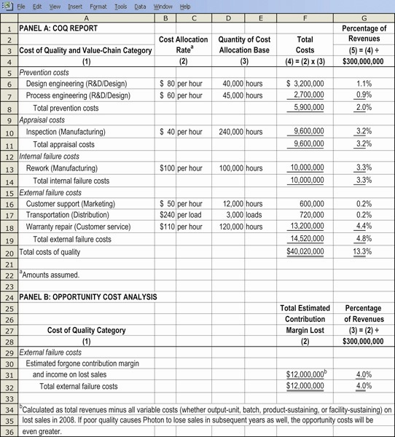
Activity-Based COQ Analysis Illustration

Slide 13
Cost of Quality Exclusions
Opportunity costs as a result of poor quality:
Contribution margin and income foregone from lost sales
Lost production
Lower prices
These opportunity costs are not recorded in the financial accounting systems.

Slide 14
Cost of Quality: Traditional View (slide added by CB)
In the 1970’s US automakers concluded that “medium” quality was optimal. They were wrong!

Slide 15
COQ Revised: Failure is more costly than assumed because of opportunity costs. P & A Less Costly than believed given modern quality control methods.

Slide 16
The Customer Perspective
Nonfinancial measures of customer satisfaction include:
Surveys on satisfaction
Market share
Number of defective units shipped to customers
Number of customer complaints
Product fail rates
Delivery delays/On-time deliveries

Slide 17
The Internal Business Process Perspective
Three techniques for identifying and analyzing quality problems:
Control charts
Pareto diagrams
Cause-and-effect diagrams

Slide 18
Control Charts
Statistical quality control (SQC) is a formal means of distinguishing between random and nonrandom variations in an operating process.
Control charts are a part of SQC.

Slide 19
Control Charts
Control charts are a graph of a series of successive observations of a particular step, procedure, or operation taken at regular intervals of time.
Each observation is plotted relative to specified ranges that represent the limits within which observations are expected to fall.
Only those observations outside the control limits are ordinarily regarded as nonrandom and worth investigating.

Slide 20
Quality Control Charts Illustrated

Slide 21
Pareto Diagrams
Problems that occur serve as inputs for Pareto diagrams.
Pareto diagram—a chart that indicates how frequently each type of defect occurs, ordered from the most frequent to the least frequent.

Slide 22
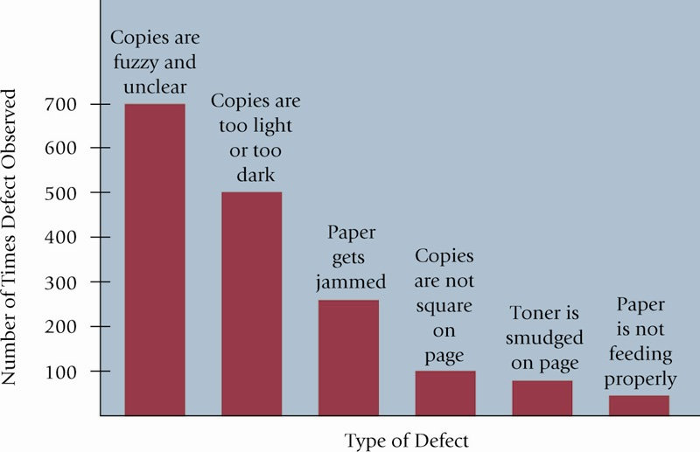
Pareto Diagram Illustration

Slide 23
Cause-and-Effect Diagrams
Identifies potential causes of defects
Problems identified by the Pareto diagram are analyzed using cause-and-effect diagrams
Also called fishbone diagrams because they resemble the bone structure of a fish

Slide 24
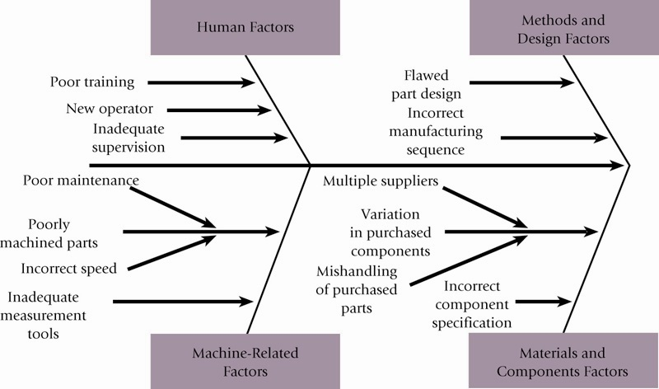
Cause-and-Effect Diagram Illustration for fuzzy & unclear copies [Mentioned only briefly]

Slide 25
Nonfinancial Measures of Internal Business Process Quality
Percentage of defective products
Percentage of reworked products
Number of different types of defects found
Number of design and process changes made

Slide 26
The Learning and Growth Perspective for Quality
Experience and qualifications of design engineers
Employee turnover ratio
Employee empowerment—number of processes in which employees have the right to make decisions without consulting supervisors
Employee satisfaction
Employee training

Slide 27
Advantages of COQ (Financial) Measures
COQ focuses managers’ attention on the costs of poor quality.
COQ measures assist in problem solving by comparing costs and benefits of different quality-improvement programs and setting priorities for cost reduction.
COQ provides a single, summary measure of quality performance for evaluating trade-offs among the costs of prevention, appraisal, internal failure, and external failure.

Slide 28
Advantages of Nonfinancial Measures of Quality
Nonfinancial measures of quality are often easy to quantify and understand.
Nonfinancial measures direct attention to physical processes and to areas that need improvement.
Nonfinancial measures provide immediate short-run feedback on whether quality-improvement efforts have succeeded.
Nonfinancial measures are useful indicators of future long-run performance.

Slide 29
Time as a Competitive Tool
Companies view time as a driver of strategy.
Operational measures of time: how quickly firms respond to customers’ demand for their products and services, and their reliability in meeting scheduled delivery dates.

Slide 30
Two Operational Measures of Time
Customer-response time—how long it takes from the time a customer places an order for a product or service is delivered to the customer
On-time performance—delivering a product or service by the time it was scheduled to be delivered

Slide 31
Customer-Response Time Illustrated

Slide 32
Time Drivers
Time driver is any factor in which a change in the factor causes a change in the speed of an activity.
Two time drivers:
Uncertainty about when customers will order products and services.
Bottlenecks due to limited capacity. A bottleneck occurs in an operation when the work to be performed approaches or exceeds the capacity available to do it.

Slide 33
Simple Time Management Principles
When demand uncertainty is high, some unused capacity it desirable.
Increasing the capacity of a bottleneck resource reduces manufacturing lead times and delays.
Reducing set-up times (non-value-added) is good.
Investment in new equipment can increase capacity.
Careful scheduling of production avoids uncertainty.

Slide 34
From p. 683:

Slide 36
The Balanced Scorecard and Time-Related Measures
Financial measures:
Revenue losses or price discounts attributable to delays
Carrying costs of inventories
Throughput contribution minus operating costs
Customer measures:
Customer-response time
On-time performance

Slide 37
The Balanced Scorecard and Time-Related Measures
Internal business process measures:
Average manufacturing time for key products
Idle time at bottleneck operations
Defective units produced at bottleneck operations
Average reduction in setup time and processing time at bottleneck operations

Slide 38
The Balanced Scorecard and Time-Related Measures
Learning and growth measures:
Employee satisfaction
Number of employees trained in managing bottleneck operations

Slide 39
